Slide 1


Bank of Baroda Hackathon - 2022
Technology Partner
Your Team Name : Futuristic
Your team bio :
Date : 20 Sep 2022

Slide 2
Problem Statement?
Why did you decide to solve this Problem statement?
I have decided to solve this problem because of below reasons:-
It involves data analytics, and this is my interest area.
The problem is interested as it involves automate the process with use of AI based techniques
KPIs analysis will become more interested with AI
Use of AI will save lots of manual efforts.
Representation of dashboards make the data easier to analyse and figure out the area of improvments for bank easily.
The feedback can be drill down into various categories automatically with use of AI , that will lead to more accurate results to bank.
Since the data nd reports will be available faster, so bank can improve the services based on feedback as early as possible.

Slide 3
User Segment & Pain Points
Which user /advertiser segment would be early adopter of your product & why?
Automation of the the process with use of AI based techniques
Automatic reports and dashboard generations to measure various KPIs
Automatic conversion of speech into various languages and lead to results in form of data analysis.
Automatic conversion of sentiment analysis from the call center recordings into data format.
Interactive dashboards

Slide 4
Pre-Requisite
What are the alternatives/competitive products for the problem you are solving?
Adobe experience manager
Zendesk
Salesforce Service Cloud
HubSpot Service Hub
Acoustic Experience Analytics (Tealeaf)
SAS Customer Experience
Medallia
Clarabridge
Genesys Cloud
Contentsquare

Slide 5
Azure tools or resources
Azure tools or resources which are likely to be used by me for the prototype, if my idea gets selected
Azure Cognitive Service for Speech to Recognize speech, synthesize speech, get real-time translations, transcribe conversations and integrate speech into your bot experiences
Python for development
Rest API
Azure AI
-Explore computer vision
-Cognitive Speech Services
-Machine Learning
-Natural Language Processing
-Explore conversational AI

Slide 6
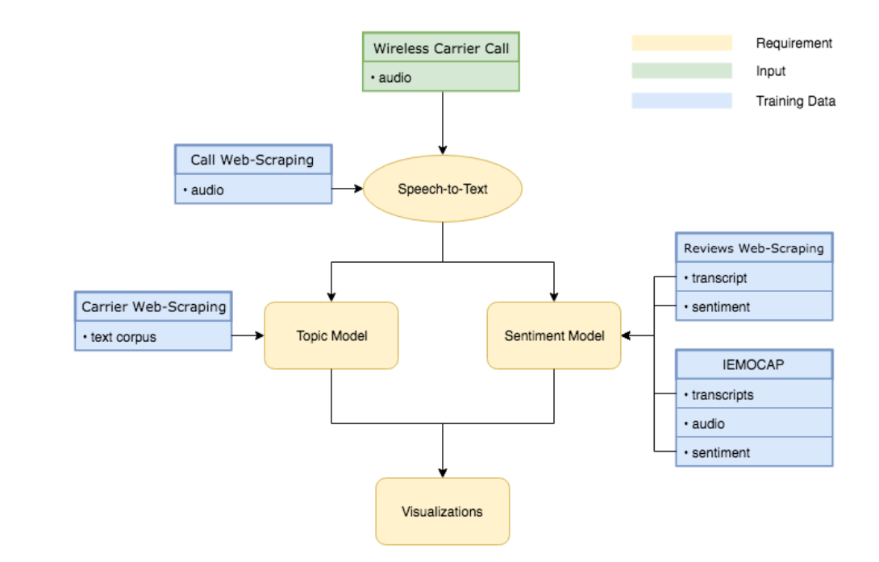
Any Supporting Functional Documents
Architecture:

Slide 7
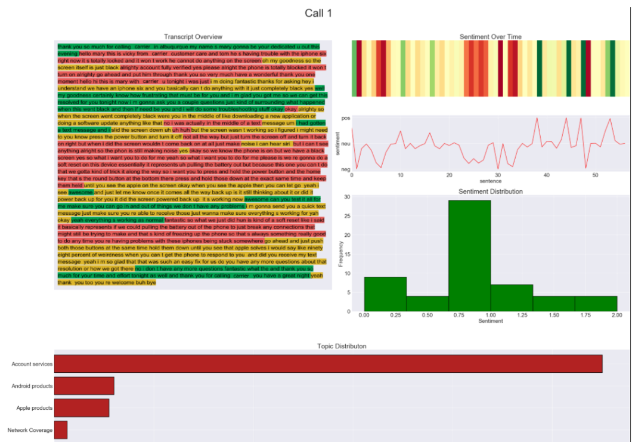
Any Supporting Functional Documents
Architecture:

Slide 8
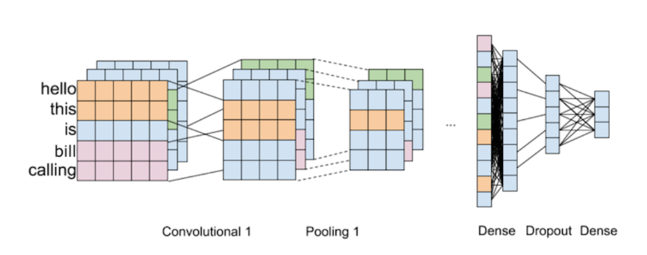
Any Supporting Functional Documents
Neural network:

Slide 9
Key Differentiators & Adoption Plan
How is your solution better than alternatives and how do you plan to build adoption?
The solution will be different because the Abstract will be as follows:
Sentiment analysis will be done to keep track of all the activities. We present a customer feedback reviews on product, where we utilize opinion mining, text mining and sentiments. With sentimental analysis, we will be dividing them Positive, Negative and Neutral Behaviour.
Speech-to-text transcription:In order to automate transcription of call data, a strategy for automated speech recognition (ASR) was required
Topic Model: To cross-analyze customer sentiment with topics of conversation, classification models will be produced to identify concepts and specific subjects in transcripts. Trends in conversational topics can be used to understand both individual customer attitudes toward products and services as well as to understand those of the general customer base.
The datasets include the integration scores of four different AI features, namely, AI-powered customer service, predictive modeling, ML-powered personalization, and natural language processing integration

Slide 10
Thank You
Team member names

